Slide 1
Fundamentals of Spatial Filtering
Digital Image Processing
Dr. Muhammad Abeer Irfan
Department of Computer Systems Engineering New UET Peshawar, Pakistan
Readings: Chapter 3 (sections 3.3 and 3.4)
How to read: at least twice, once laid back, once with full focus.
1 / 41

Slide 2
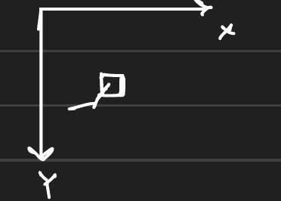
Image Processing
We can perform image processing under two principal domains:
Spatial domain.
Frequency domain.
Spatial domain: We can perform processing directly on a single pixel, present in the image plane.
Frequency domain: We can’t perform any processing directly on the input image.
We convert the original image into a Fourier transform and then perform operations on the transformed image.
Take the inverse Fourier transform of the processed image to get back the image in the spatial domain.

Slide 3
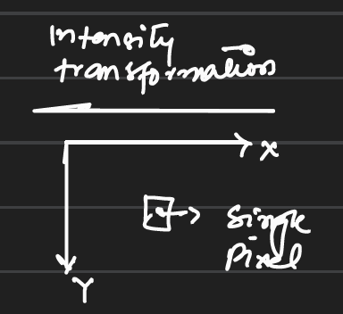
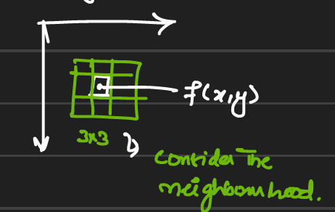
Spatial domain
Processing in spatial domain:
Intensity transformation
Performed on a single pixel in an image plane
Spatial filtering
The operation is performed on a pixel by
considering its neighborhood of
n x n filter/ mask.

Slide 4
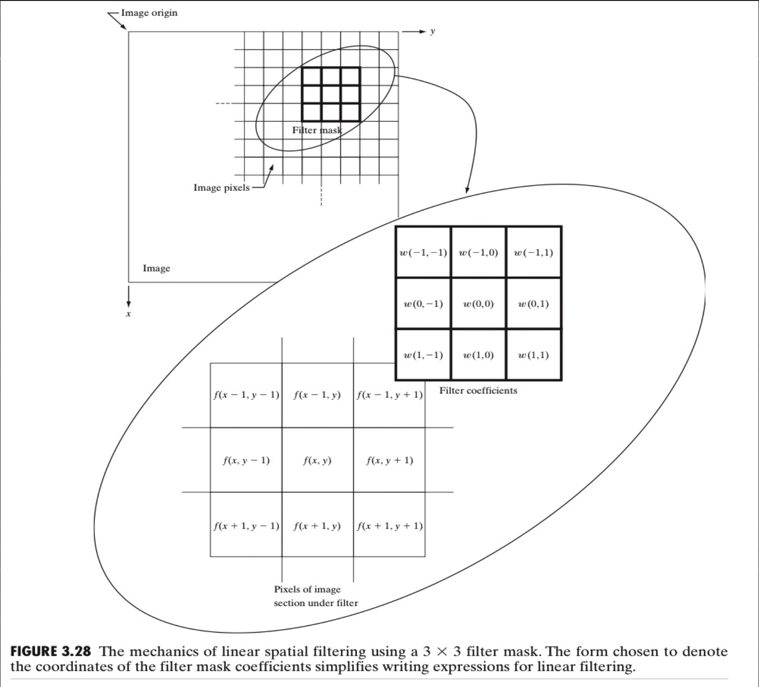
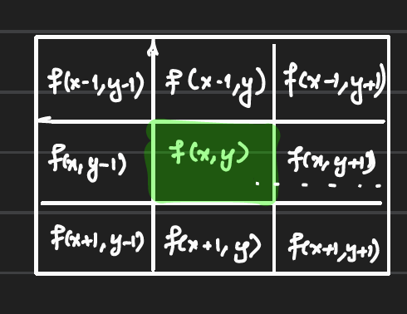
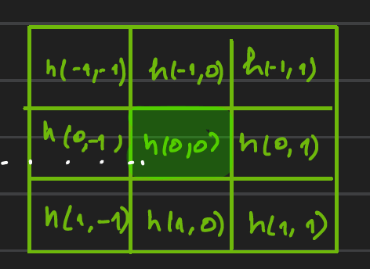
Filters
Filter can be of size (3x3, 5x5, 7x7, …..)
A filter can also be known as a mask, template, window, and kernel.
If the operation performed on the neighboring pixels is linear, it is called “ Linear Spatial Filter”
coincide

Slide 5
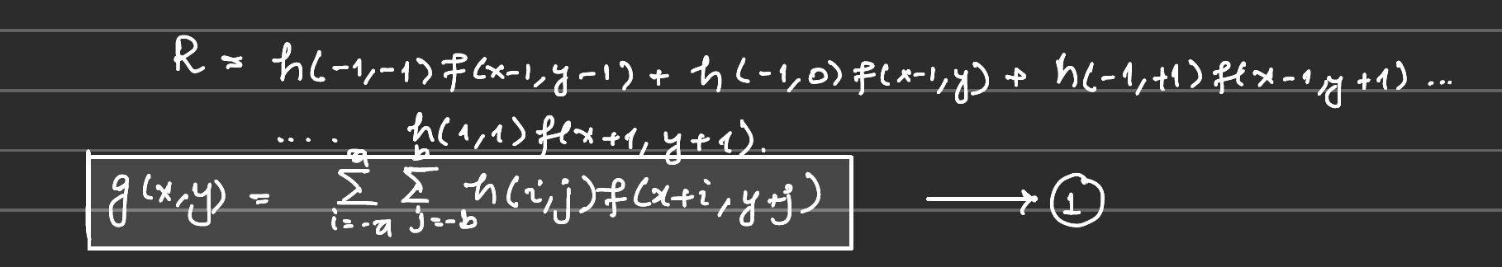
Response of the filter
The response of the filter can be written as:
Other representaion:
Suppose, we have a template of 3x3 and tneighborhood
h₁ | h₂ | h₃
h₄ | h₅ | h₆
h₇ | h₈ | h₉
Z₁ | Z₂ | _{Z3}
Z₄ | Z₅ | Z₆
Z₇ | Z₈ | Z₉

Slide 6
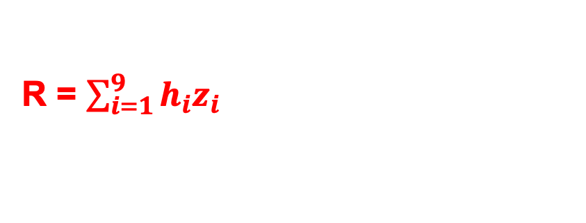
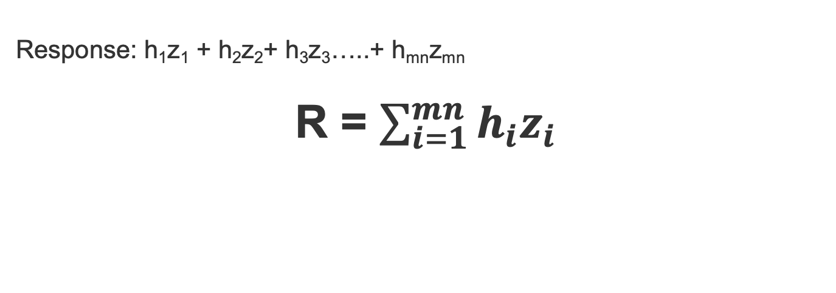
Cont’d
Response: h₁z₁ + h₂z₂+ h₃z₃…..+ h_{mn}z_{mn}
R = $\sum_{i=1}^{mn}{h_{i}z_{i}}$
R = $\sum_{i=1}^{9}{h_{i}z_{i}}$

Slide 7
Types of spatial filters
There are two types of spatial filters.
Smoothing spatial filters.
Sharpening spatial filters.
Smoothing Spatial Filters:
Smoothing filters can further be classified as:
Linear filters.
Non-linear filters (Order statistics)

Slide 8
Smoothing Spatial Filters
These filters can be used to:
Remove the noise present in the original image
To blur the image
To extract the object in the image
To remove the small objects in the image
Linear Smoothing Spatial Filters
Primarily used to:
Create the blurring effect
Remove the noise
Also called “Averaging spatial filters”

Slide 9
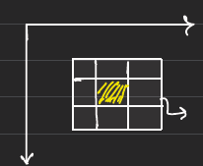
Response of the linear smoothing filters
The response of the linear smoothing filter is the “average” of the intensity values of its m x n neighbors and is assigned it to the centered pixel.
This operation is performed on pixel-to-pixel by shifting it
This finds the average of its neighboring pixels and assigns it to the shaded pixel. This mainly provides the blurriness and smoothens the image.
This is mainly used in applications like dealing with random noises in an image.

Slide 10
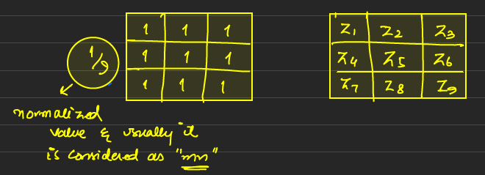
Cont’d
The random noise has a very sharp intensity transition.
To deal with such sharp-intensity transitions, we can perform a linear smoothing filter, where the filter replaces each pixel with the average of its m x n neighbors.
Limitation: It causes the blurriness of the edges of the objects, which is an important feature in an image.

Slide 11
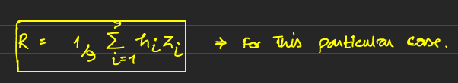
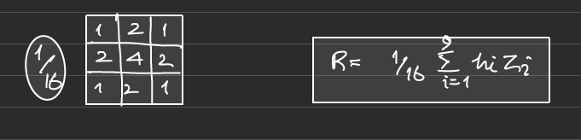
Cont’d
Response:
In the weighted linear smoothing filter, we normalized the mask by the with of its coefficients e.g

Slide 12
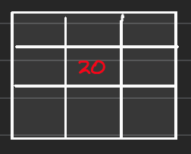
Non-Linear Filters (Median Filter)
Mainly used to remove the noise present in the image.
It also provides a considerable amount of blurriness.
It is primarily used in cases, where we are dealing with impulse noise such as salt and pepper noise).
In a non-linear filter, we use a median filter
For example, if an image patch is:
{10, 25,20, 20, 20, 100,20,20,15}
sorted: {10, 15, 20, 20,20, 20, 20,25, 10}

Slide 13
Max Filter
In the max filter, the center pixel value will be the max value of the neighborhood.
Enhances edges and highlights by expanding the size of bright regions, making it useful for emphasizing features in images where bright details are crucial.
Used in image preprocessing for feature extraction, especially in applications like object detection, medical imaging, and optical character recognition (OCR).
Note: Can lead to loss of finer details and increased noise if not carefully applied, as it tends to brighten all pixels in the neighborhood indiscriminately.
Parameter tuning, such as the size of the neighborhood, is essential for optimal performance.
R =Max {Z_{k} | K = 1, 2,.. . . . mn}

Slide 14
Min Filter
The min filter is a nonlinear filter that replaces each pixel's value with the minimum value within a specified neighborhood, enhancing dark features in an image.
Effective at reducing certain types of noise, such as salt-and-pepper noise, by eliminating small bright spots while preserving the overall structure of dark regions.
Preserves edges by contracting bright regions and emphasizing dark features, making it useful for applications where the integrity of dark details is important.
Used in image preprocessing for tasks such as shadow enhancement, background subtraction, and improving the visibility of dark structures in medical and astronomical imaging.
R =min {Z_{k} | K = 1, 2,.. . . . mn}

Slide 15
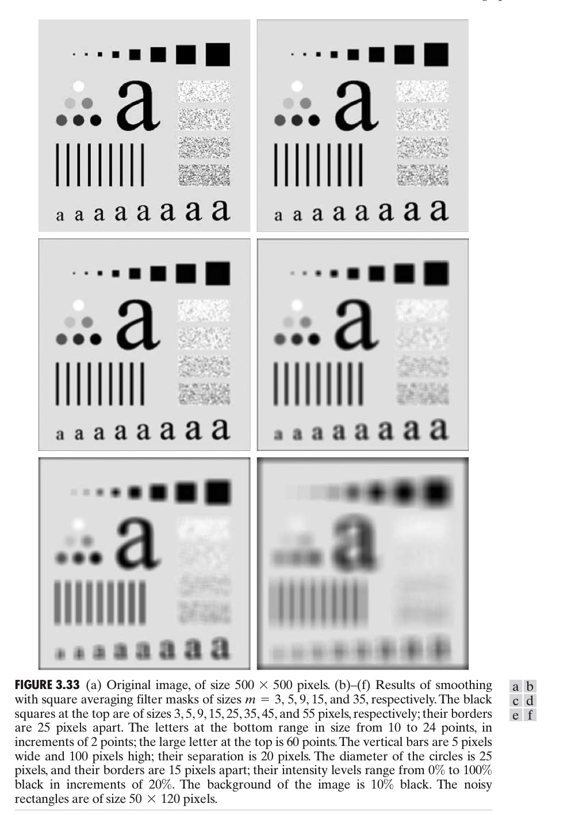
Results

Slide 16
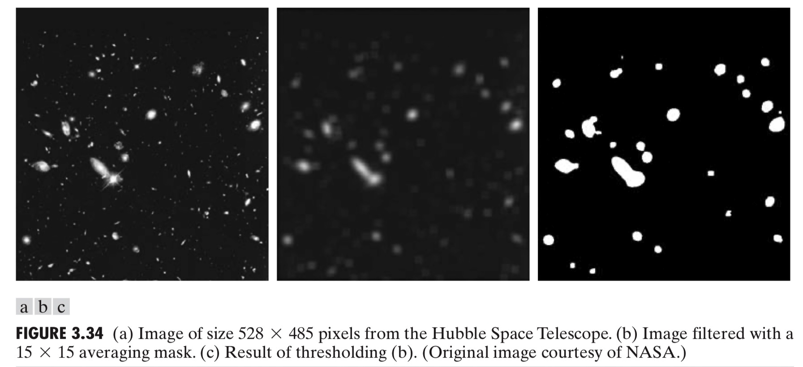
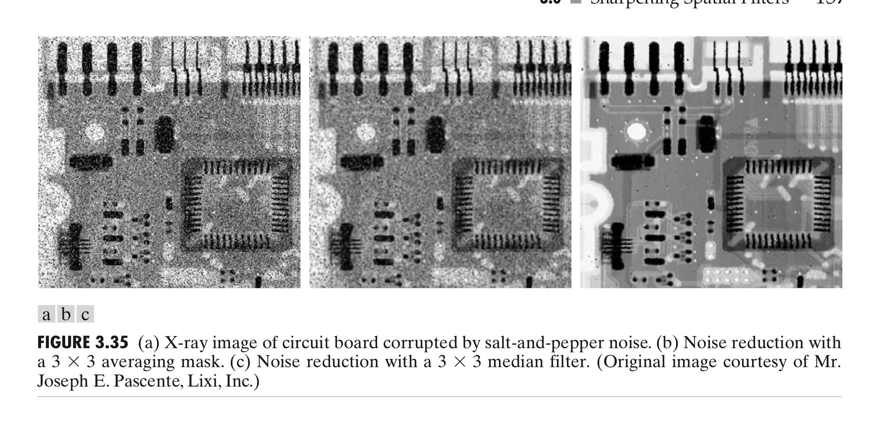

Slide 17
Sharpening Filter
Sharpening filters are used to highlight transitions in intensities, enhancing edges and fine details in an image.
They perform the reverse operation of smoothing spatial filters. While smoothing filters blur the image by averaging pixel values, sharpening filters increase contrast by emphasizing differences in intensities.
In smoothing filters, blurring is achieved by averaging the pixels of the neighborhood. Averaging is analogous to the integration operation.
In sharpening spatial filtering, spatial differentiation is performed. This process involves calculating the gradient or Laplacian of the image to emphasize regions with high spatial frequency, such as edges.

Slide 18
Types of sharpening Filters
Laplacian Filter: Uses the Laplacian operator to highlight areas of rapid intensity change.
Gradient-Based Filters: Such as the Sobel or Prewitt operators, which compute the gradient magnitude and direction for edge detection and enhancement.
Applications:
Used in medical imaging to enhance the visibility of structures.
Important in computer vision tasks like object detection, feature extraction, and image segmentation.
Enhances details in photographs and scanned images for better visual quality.

Slide 19
Consideration
Can amplify noise along with edges, so it is important to apply noise reduction techniques before sharpening.
The choice of kernel size and type affect the sharpening effect, requiring careful parameter tuning based on the specific application.

Slide 20
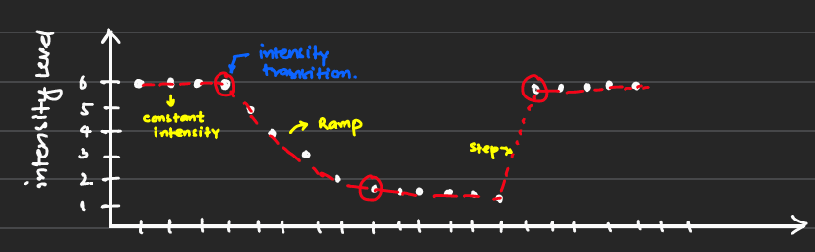
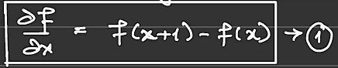
First Order Derivative
Let's assume a 1-D function.
The 1st order derivate for 1-D function is given by:

Slide 21
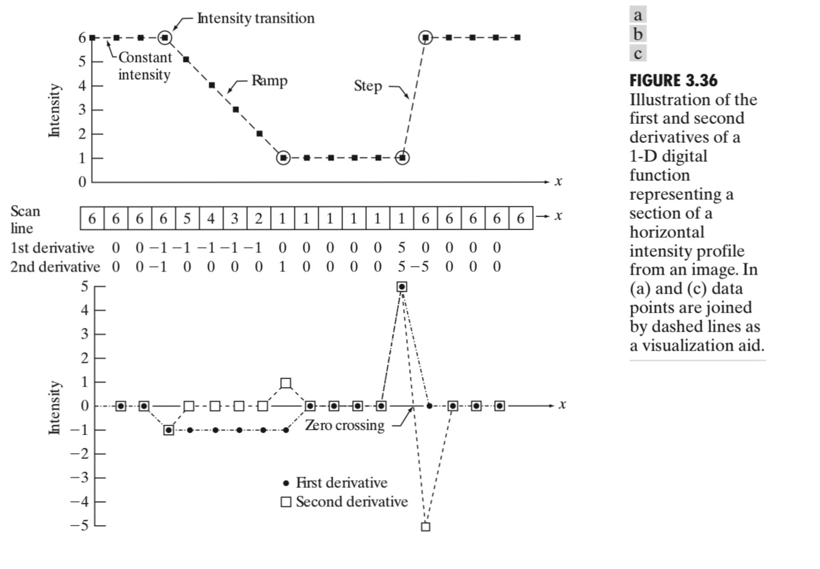
Con’td
For constant intensities, the 1st order derivate is zero.
The onset of the ramp and steps must be non-zero.
Along the ramp, the derivative must be non-zero

Slide 22
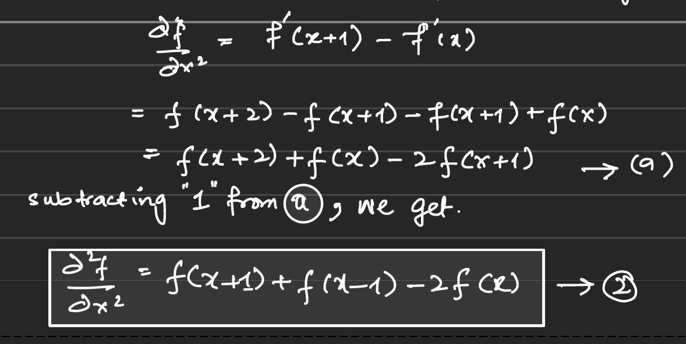
Second Order Derivative
The second order derivative for a 1-D function is given by:

Slide 23
Cont’d
For constant intensities, the 2nd-order derivate is zero.
The onset/end of the ramp/step must be non-zero.
Along the ramp/constant slope, the 2nd order derivative must be zero.

Slide 24
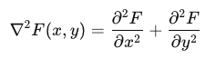
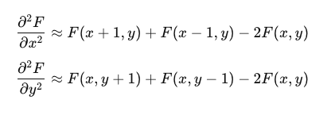
Laplacian (Using 2nd order-derivative)
We will learn how to develop the Laplacian mask using the 2nd-order derivative for a 2-D image. Let's take a 2-D function 𝐹(𝑥,𝑦).
Laplacian Operator:
The Laplacian operator is a 2nd-order derivative operator, used to highlight regions of rapid intensity change (edges) in an image. It is defined as:
For a discrete 2-D image, the second-order derivatives can be approximated using finite differences:

Slide 25
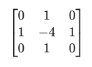
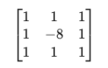
Laplacian Mask
Combining the approximations, the discrete Laplacian can be represented using a convolution mask:
This can be implemented using the following convolution kernel:
(1)
alternatively, a slightly different form of the Laplacian kernel, which is rotation invariant, is:
(2)

Slide 26
Con’td
Rotation Invariant Property:
The Laplacian is rotation invariant, meaning its response is the same regardless of the orientation of the edges in the image. This makes it useful for detecting edges in images where the orientation of features varies.
By applying the Laplacian mask to an image, you can detect edges and enhance details by highlighting regions of rapid intensity change.

Slide 27
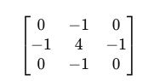
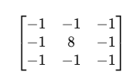
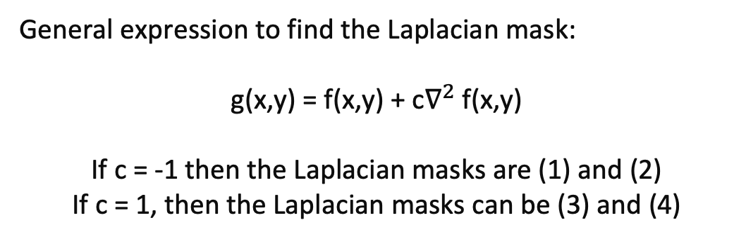
Con’td
General expression to find the Laplacian mask:
g(x,y) = f(x,y) + c$∇^{2}$ f(x,y)
If c = -1 then the Laplacian masks are (1) and (2)
If c = 1, then the Laplacian masks can be (3) and (4)
(3)
(4)

Slide 28
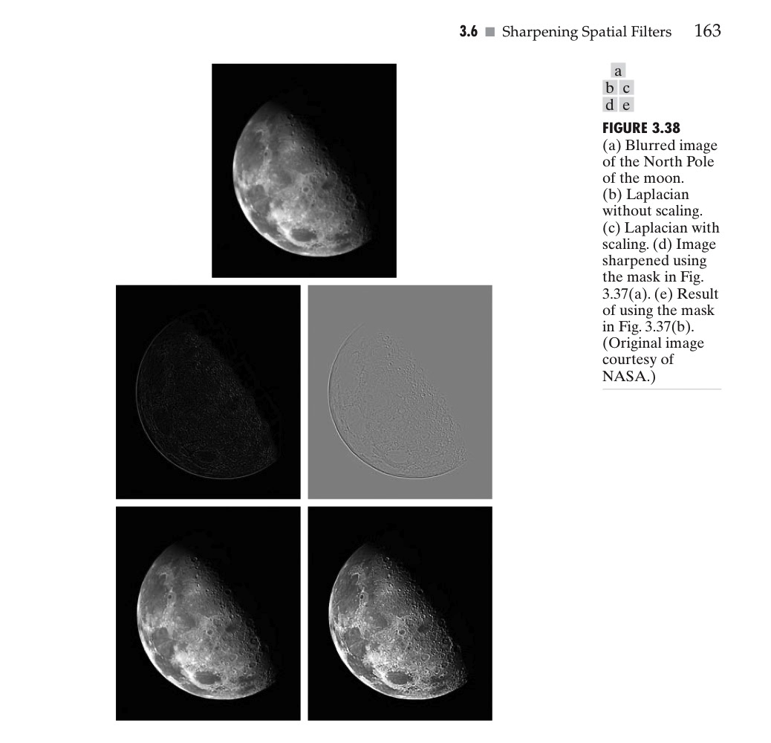

Slide 29
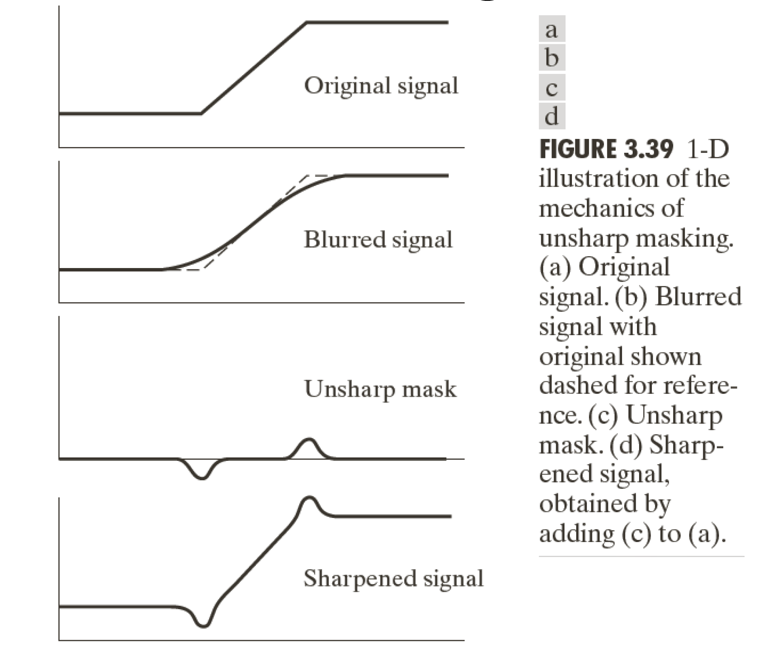
Unsharp Masking and High boost Filtering

Slide 30
Cont’d
Unsharp Masking
– Read Original Image f(x,y)
– Blurred original image f’(x,y)
– Mask = f(x,y) – f’(x,y)
– g(x,y) = f(x,y) + Mask
High Boost Filtering
– Read Original Image f(x,y)
– Blurred original image f’(x,y)
– Mask = f(x,y) – f’(x,y)
– g(x,y) = f(x,y) + k*Mask, where k>1

Slide 31
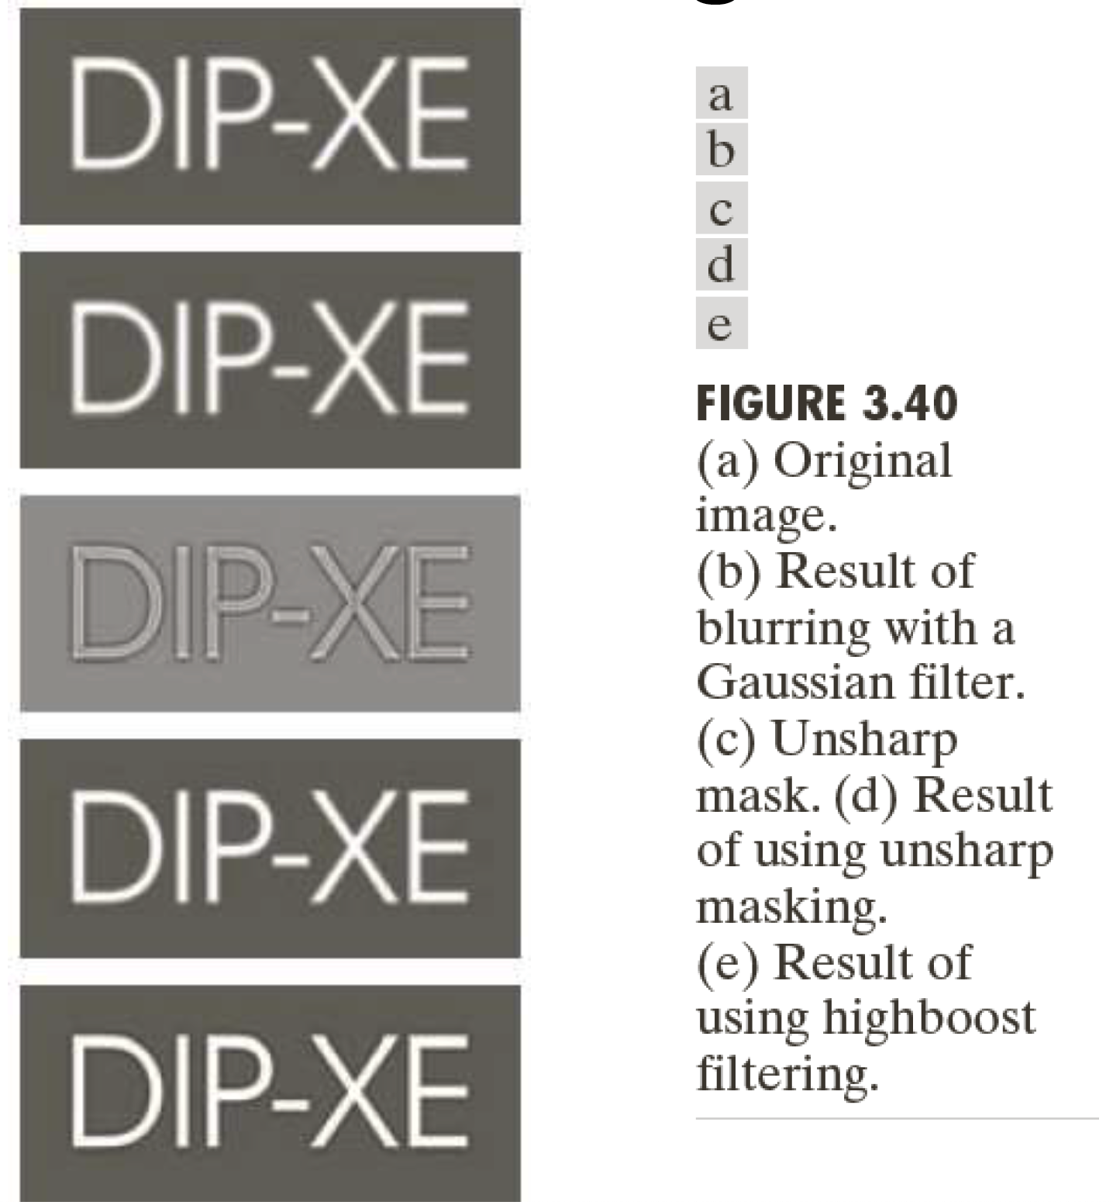
Cont’d

Slide 32
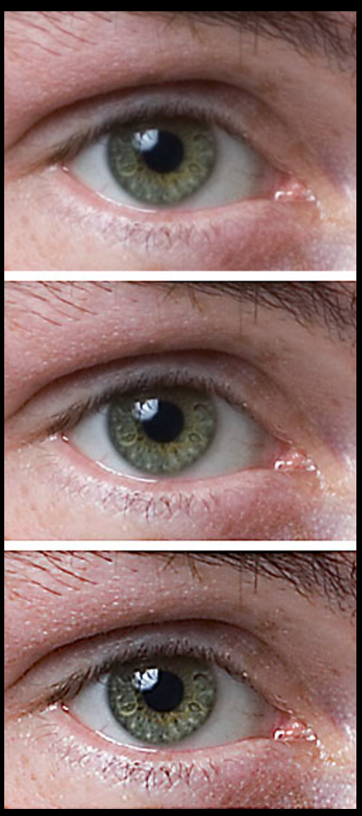
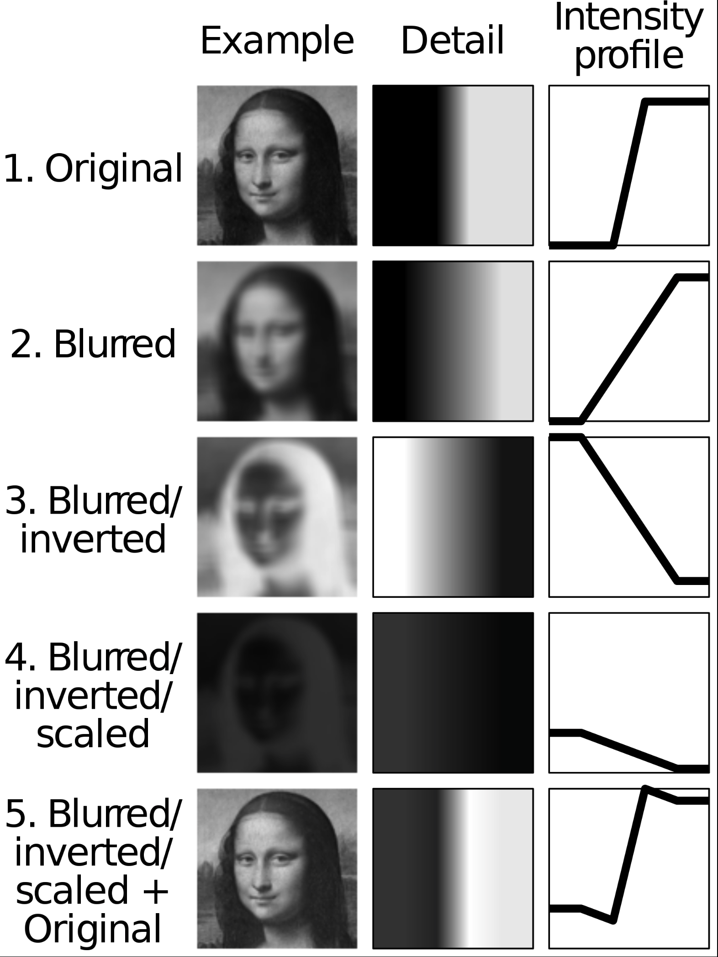
Results

Slide 33
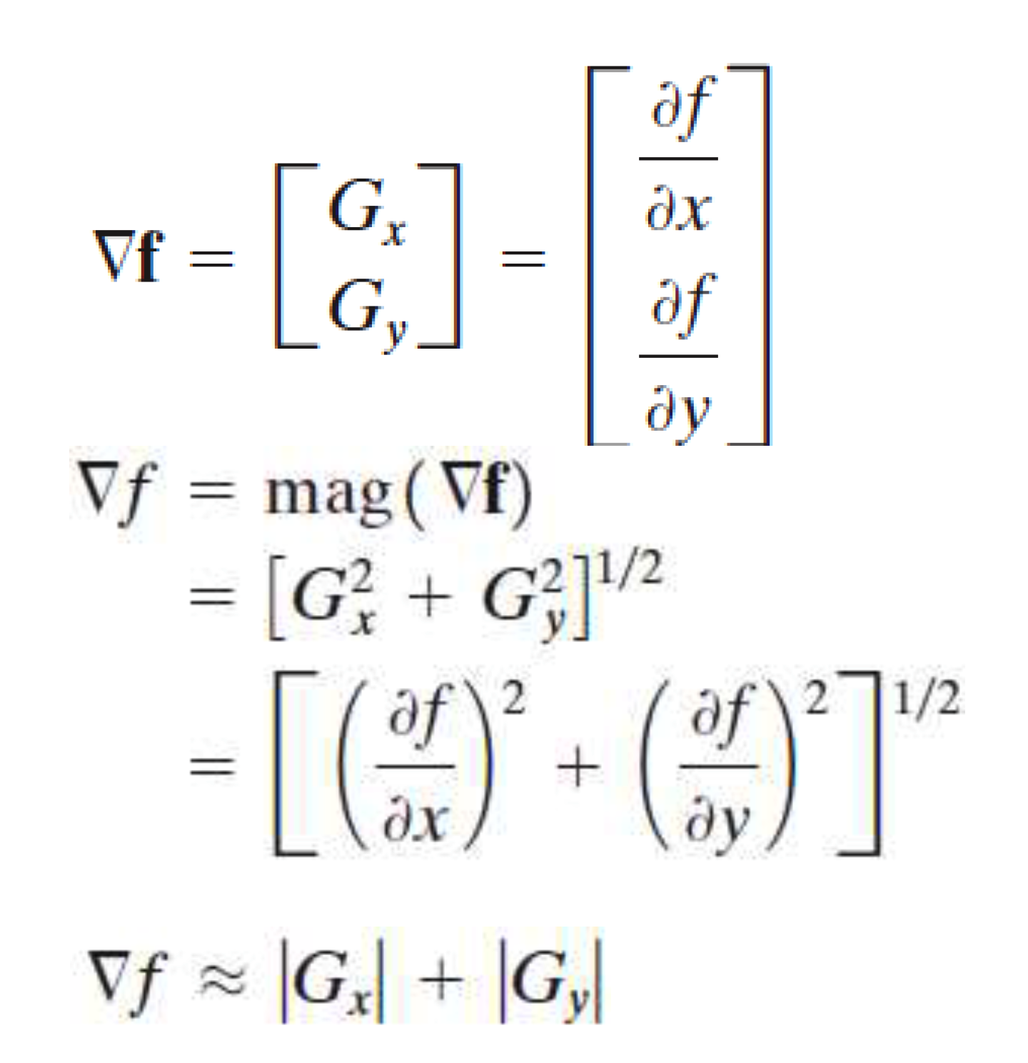
First Derivative – The Gradient

Slide 34
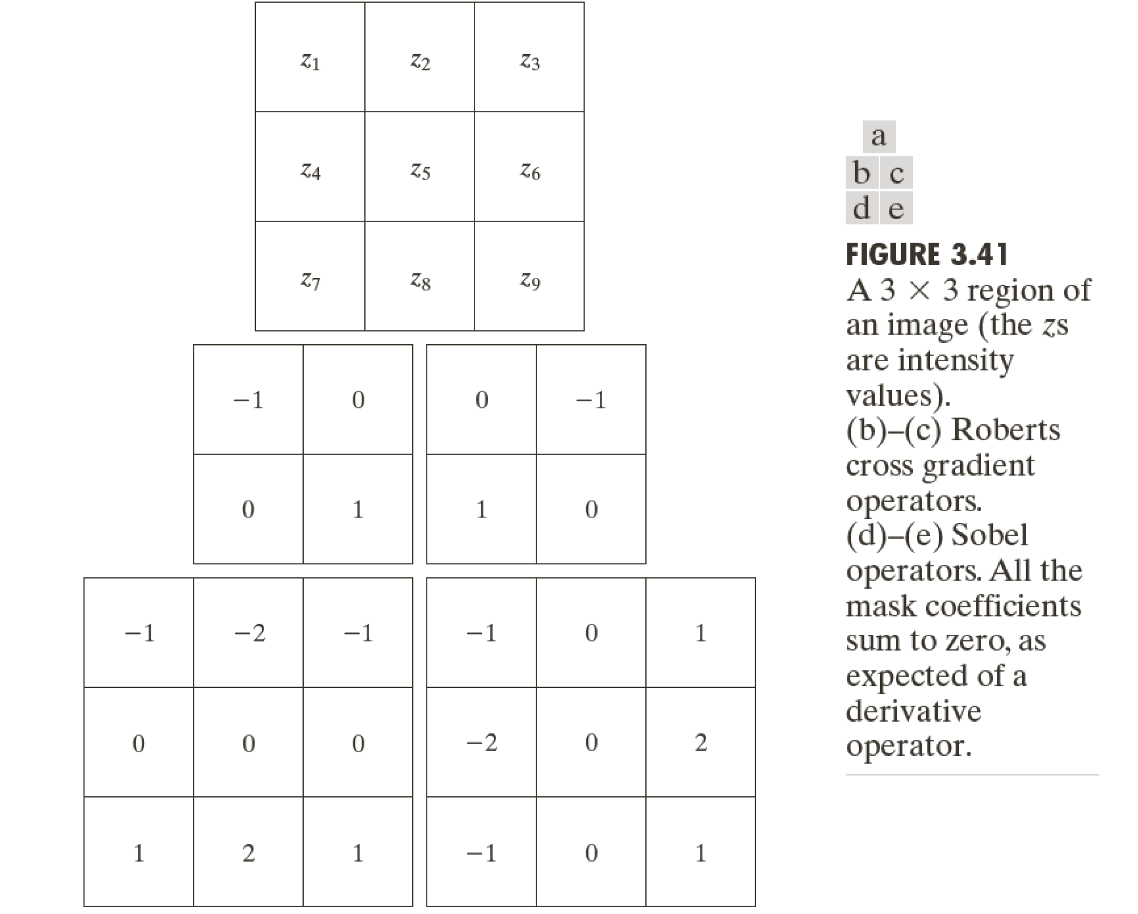

Slide 35
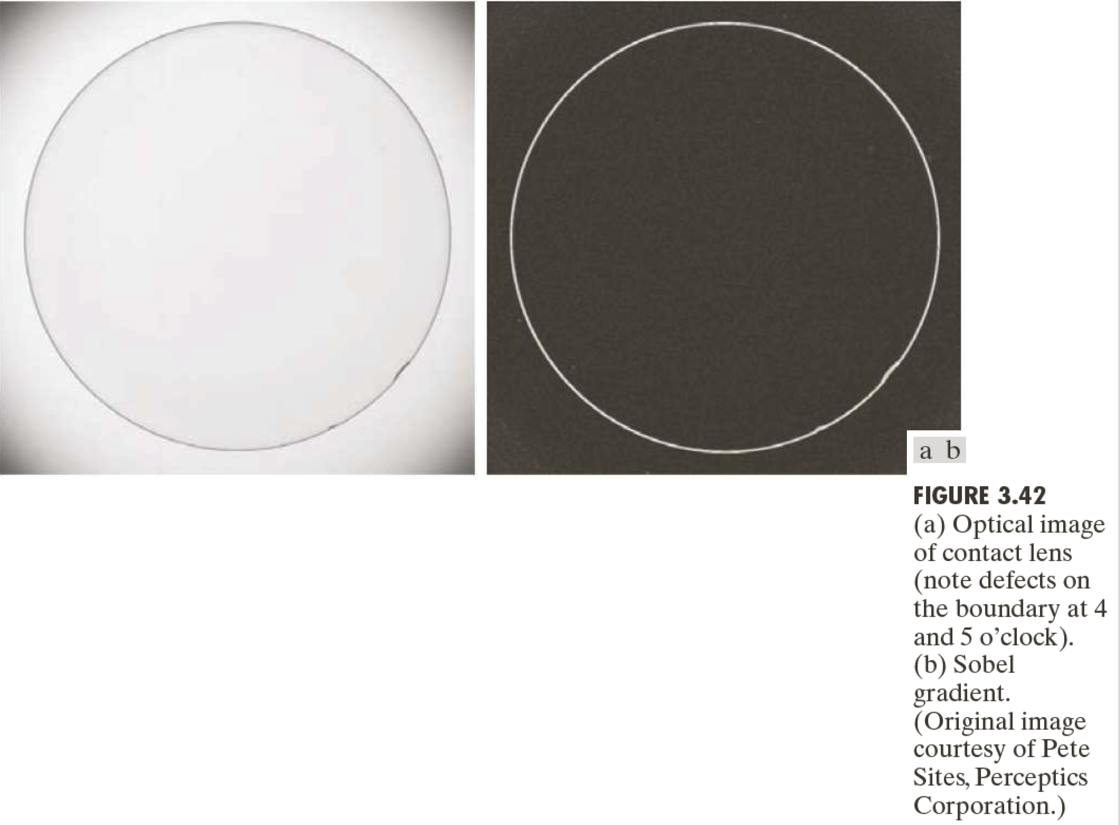

Slide 36
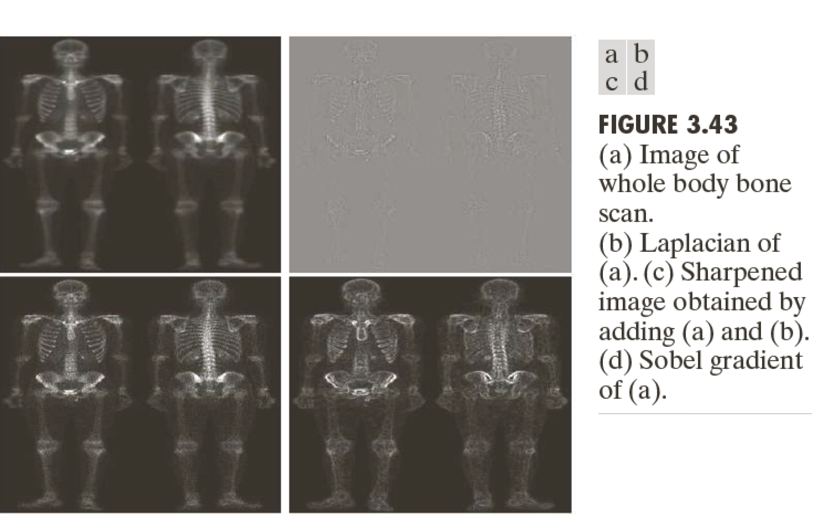
Combining Spatial Enhancement Methods

Slide 37
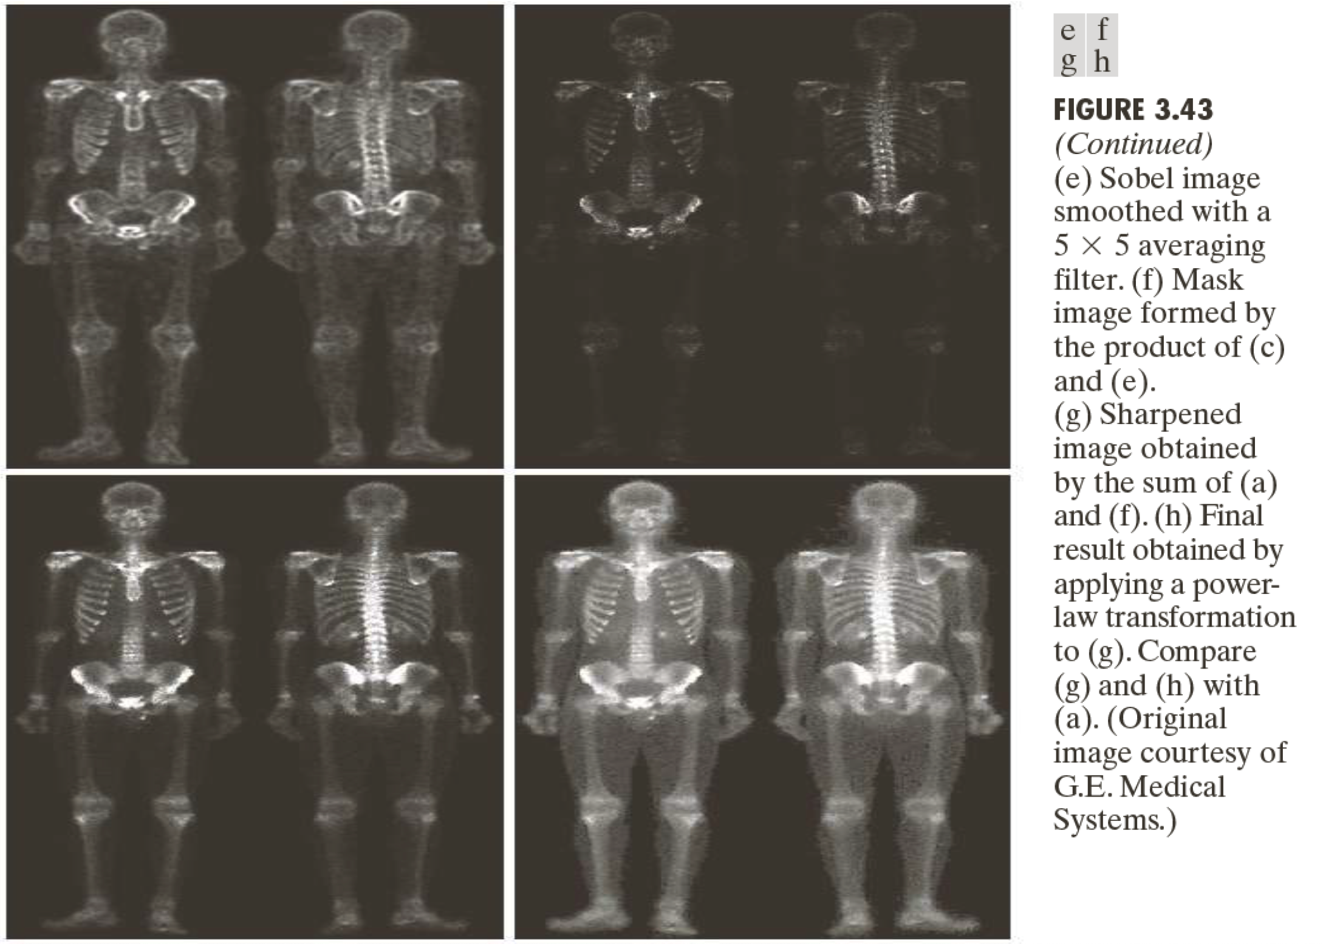
Cont’d

